Slide 1

A PROJECT REPORT ON
MALIGNANT COMMENT CLASSIFIER
SUBMITTED BY
HIMAJA IJJADA
Caution - Please view the presentation as a slide show for better experience

Slide 2
TOPICS TO BE DISCUSSED
Introduction
Problem statement
Conceptual Background of the Domain Problem
Motivation for the Problem Undertaken
Mathematical/ Analytical Modeling of the Problem
Data Sources and their formats
Data Preprocessing Done
Software Used
Visualizations
Model/s Development and evaluation
Interpretation of the Results
Key Findings and Conclusions of the Study

Slide 3
Introduction
The proliferation of social media enables people to express their opinions widely online. However, at the same time, this has resulted in the emergence of conflict and hate, making online environments uninviting for users. Although researchers have found that hate is a problem across multiple platforms, there is a lack of models for online hate detection.
Online hate, described as abusive language, aggression, cyberbullying, hatefulness and many others has been identified as a major threat on online social media platforms. Social media platforms are the most prominent grounds for such toxic behaviour.
There has been a remarkable increase in the cases of cyberbullying and trolls on various social media platforms. Many celebrities and influences are facing backlashes from people and have to come across hateful and offensive comments. This can take a toll on anyone and affect them mentally leading to depression, mental illness, self-hatred and suicidal thoughts.

Slide 4
Problem statement
Internet comments are bastions of hatred and vitriol. While online anonymity has provided a new outlet for aggression and hate speech, machine learning can be used to address it. The problem we sought to solve was the tagging of internet comments that are offensive towards other users, which means that insults to third parties such as celebrities will be tagged as inoffensive, but they may be clearly offensive.
Our goal is to build a prototype of online hate and abuse comment classifier which can used to classify hate and offensive comments so that it can be controlled and restricted from spreading hatred and cyberbullying.

Slide 5
Conceptual Background of the Domain Problem
Online platforms and social media become the place where people share the thoughts freely without any partiality and overcoming all the race people share their thoughts and ideas among the crowd.
Social media is a computer-based technology that facilitates the sharing of ideas, thoughts, and information through the building of virtual networks and communities. By design, social media is Internet-based and gives users quick electronic communication of content. Content includes personal information, documents, videos, and photos. Users engage with social media via a computer, tablet, or smartphone via web-based software or applications.
In this huge online platform or an online community there are some people or some motivated mob willfully bully others to make them not to share their thought in rightful way. They bully others in a foul language which among the civilized society is seen as ignominy. And when innocent individuals are being bullied by these mob these individuals are going silent without speaking anything. So, ideally the motive of this disgraceful mob is achieved.
To solve this problem, we are now building a model that identifies all the foul language and foul words, using which the online platforms like social media principally stops these mob using the foul language in an online community or even block them or block them from using this foul language.

Slide 6
Motivation for the Problem Undertaken
The exposure to real world data and the opportunity to deploy my skillset in solving a real time problem has been the primary objective. However, the motivation for taking this project was that it is relatively a new field of research. Here we have many options but less concrete solutions.
The main motivation is to build a prototype of online hate and abuse comment classifier which can used to classify hate and offensive comments so that it can be controlled and restricted from spreading hatred and cyberbullying.

Slide 7
Mathematical/ Analytical Modeling of the Problem
Here in this project, we have been provided with two datasets namely train and test CSV files. I will build a machine learning model by using NLP using train dataset. And using this model we will make predictions for our test dataset.
I will need to build multiple classification machine learning models. Before model building will need to perform all data pre-processing steps involving NLP. After trying different classification models with different hyper parameters then will select the best model out of it. Will need to follow the complete life cycle of data science that includes steps like -
1. Data Cleaning
2. Exploratory Data Analysis
3. Data Pre-processing
4. Model Building
5. Model Evaluation
6. Selecting the best model
Finally, we compared the results of proposed and baseline features with other machine learning algorithms. Findings of the comparison indicate the significance of the proposed features in cyberbullying detection.

Slide 8
Data Analysis steps :
Import Libraries
Import Dataset
Data Pre Processing
Ordinal encoding
Visualization
Finding null values

Slide 9
Data Sources and their formats

Slide 10
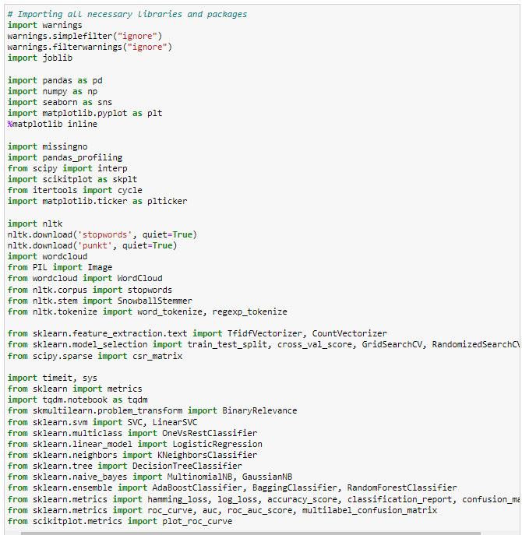
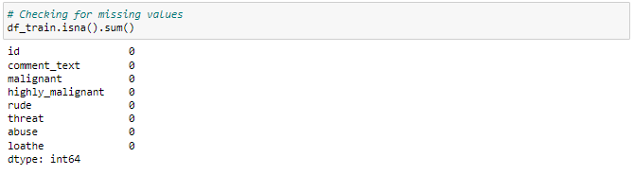
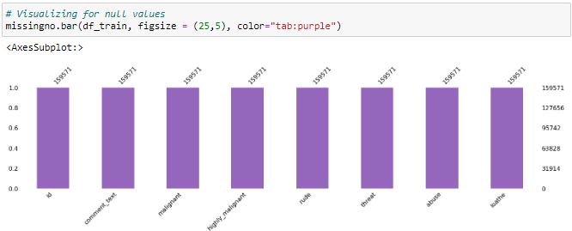
Data Preprocessing Done
We have imported all the necessary libraries/packages.
Checking the shape of the train dataset
Checking for missing values
Using the isna and sum options together we can confirm that there are no missing values in any of the columns present in our training dataset.
Visualizing for null values
This is to ensure that there is no missing data in the dataset using missingno.
Importing all necessary libraries and packages

Slide 14
Assumptions
These are the comments that belongs to different type so which the help of word cloud we can see if there is abuse comment which type of words it contains and similar to other comments as well.
From wordcloud of malignant comments, it is clear that it mostly consists of words like fuck, nigger, moron, hate, suck ect.
From wordcloud of highly_malignant comments, it is clear that it mostly consists of words like ass, fuck, bitch, shit, die, suck, faggot ect.
From wordcloud of rude comments, it is clear that it mostly consists of words like nigger, ass, fuck, suck, bullshit, bitch etc.
From wordcloud of threat comments, it is clear that it mostly consists of words like die, must die, kill, murder etc.
From wordcloud of abuse comments, it is clear that it mostly consists of words like moron, nigger, fat, jew, bitch etc.
From wordcloud of loathe comments, it is clear that it mostly consists of words like nigga, stupid, nigger, die, gay cunt etc.

Slide 15
Cyberbullying has become a growing problem in countries around the world. Essentially, cyberbullying doesn’t differ much from the type of bullying that many children have unfortunately grown accustomed to in school. The only difference is that it takes place online.
Cyberbullying is a very serious issue affecting not just the young victims, but also the victims' families, the bully, and those who witness instances of cyberbullying. However, the effect of cyberbullying can be most detrimental to the victim, of course, as they may experience a number of emotional issues that affect their social and academic performance as well as their overall mental health.

Slide 16
Software Used
Distribution: Anaconda Navigator
Programming language: Python
Browser based language shell: Jupyter Notebook
Word cloud: For visual display of text data
Libraries/Packages specifically being used - Pandas, NumPy, matplotlib, seaborn, scikit-learn, pandas-profiling, missingno, NLTK

Slide 17
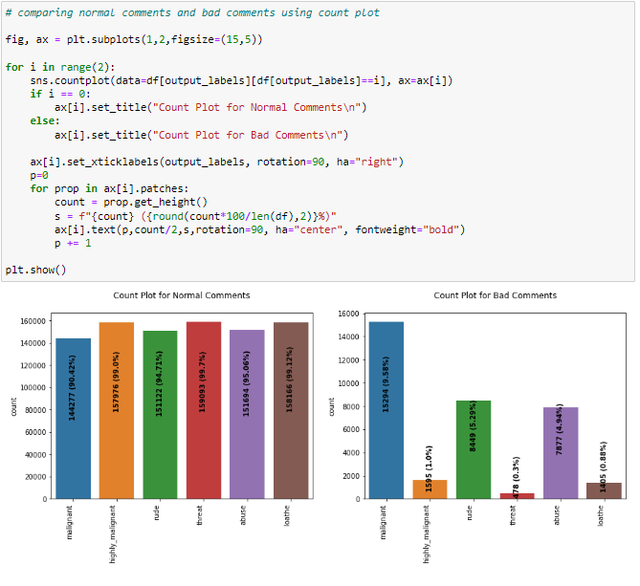
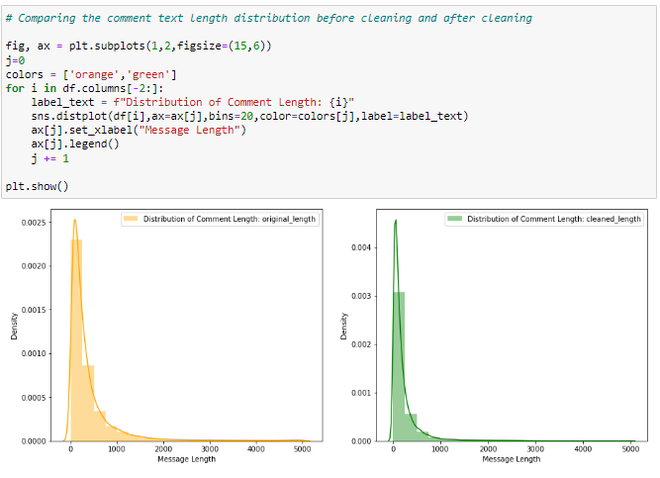
Visualizations
Observation:
- Dataset consists of higher number of Normal Comments than Bad or Malignant Comments. Therefore, it is clear that dataset is imbalanced and needs to be handle accordingly.
- Most of the bad comments are of type malignant while least number of type threat is present in dataset.
- Majority of bad comments are of type malignant, rude and abuse.
Observation:
- Before cleaning comment_text column most of the comment's length lies between 0 to 1100 while after cleaning it has been reduced between 0 to 900.

Slide 18
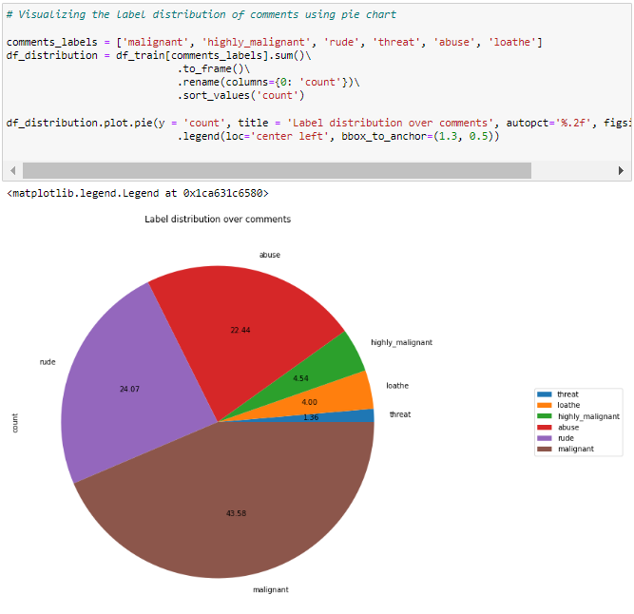
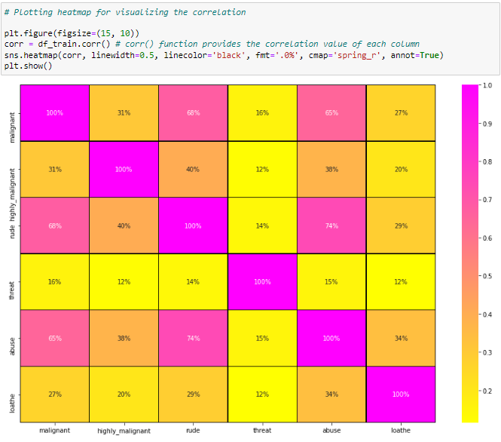

Slide 19
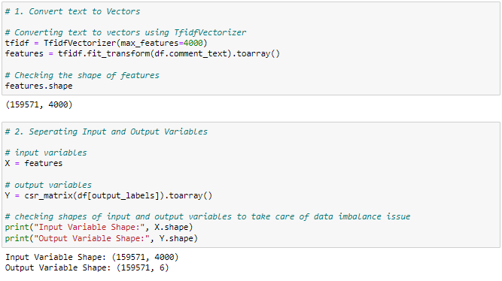
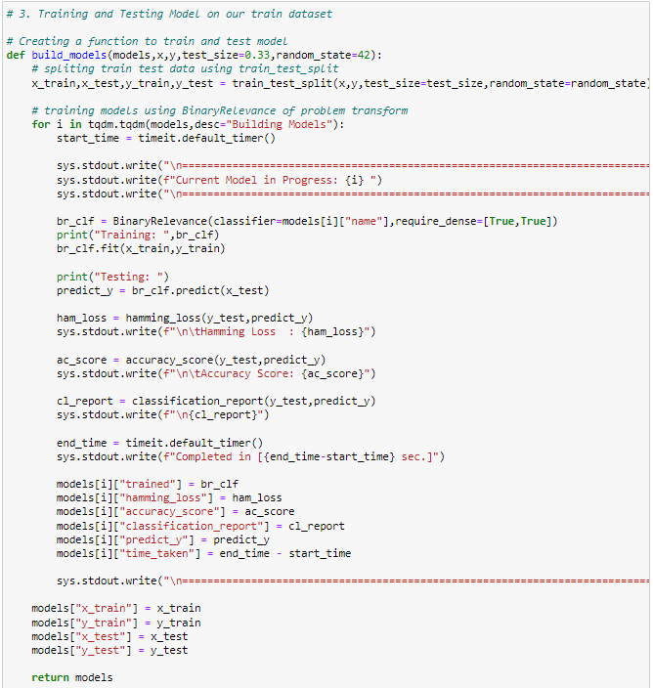
Model/s Development and evaluation

Slide 22
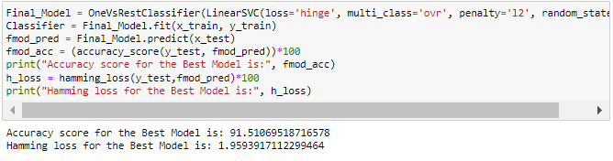
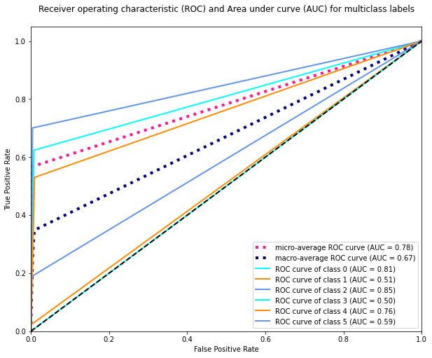
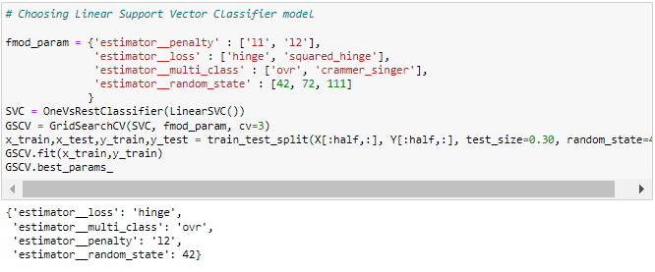
After comparing all the classification models I have selected Linear Support Vector Classifier as my best model and have listed down it's parameters above referring the sklearn webpage. I am using the Grid Search CV method for hyper parameter tuning my best model. I have trained the Grid Search CV with the list of parameters I feel it should check for best possible outcomes. So the Grid Search CV has provided me with the best parameters list out of all the combinations it used to train the model that I can use on my final model.
I have successfully incorporated the Hyper Parameter Tuning on my Final Model and received the accuracy score for it.
AUC ROC Curve for Final Model

Slide 23
Interpretation of the Results
Starting with univariate analysis, with the help of count plot it was found that dataset is imbalanced with having higher number of records for normal comments than bad comments (including malignant, highly malignant, rude, threat, abuse and loathe). Also, with the help of distribution plot for comments length it was found that after cleaning most of comments length decreases from range 0-1100 to 0-900. Moving further with word cloud it was found that malignant comments consists of words like fuck, nigger, moron, hate, suck etc. highly_malignant comments consists of words like ass, fuck, bitch, shit, die, suck, faggot etc. rude comments consists of words like nigger, ass, fuck, suck, bullshit, bitch etc. threat comments consists of words like die, must die, kill, murder etc. abuse comments consists of words like moron, nigger, fat, jew, bitch etc. and loathe comments consists of words like nigga, stupid, nigger, die, gay, cunt etc

Slide 24
Key Findings
The finding of the study is that only few users over online use unparliamentarily language. And most of these sentences have more stop words and are being quite long. As discussed before few motivated disrespectful crowds use these foul languages in the online forum to bully the people around and to stop them from doing these things that they are not supposed to do. Our study helps the online forums and social media to induce a ban to profanity or usage of profanity over these forums.

Slide 25
Conclusions of the Study
I found that the dataset was quite interesting to handle. Improvement in computing technology has made it possible to examine social information that cannot previously be captured, processed and analysed. New analytical techniques of machine learning can be used in property research. The power of visualization has helped us in understanding the data by graphical representation it has made me to understand what data is trying to say. Data cleaning is one of the most important steps to remove unrealistic values and stopwords.
Through this project we were able to learn various Natural language processing techniques like lemmatization, stemming, removal of stopwords. We were also able to learn to convert strings into vectors through hash vectorizer. In this project we applied different evaluation metrics like log loss, hamming loss besides accuracy. This study is an exploratory attempt to use four machine learning algorithms in estimating malignant comments, and then compare their results.
To conclude, the application of machine learning in malignant classification is still at an early stage. We hope this study has moved a small step ahead in providing some methodological and empirical contributions to crediting institutes, and presenting an alternative approach to the valuation of malignance. We all need to be aware of social sense and use the relatively suitable words which does not demean or degrade the other person or entity and also avoid using abusive, vulgar and mean words in social media. It can cause many problems which could affect the lives of people around us. Try to be polite, calm, empathetic and composed while handling stress and negativity and one of the best solutions is to avoid it and overcoming in a positive manner. Criticism can be given in a constructive way unless it does not hurt other’s feelings.

Slide 26
Thank you

